Slide 1
CS2040 Lab09 B03 (Please set up your camera for Visualgo quiz) 26/10/2020

Slide 2
POP MIDDLE

Slide 3
PROBLEM
Implement a Queue that can support 3 operations
Push back
Pop front
Pop middle
Using default data structures is not fast enough
FIFO concept
Removing from the middle is O(N)!

Slide 4
DATA STRUCTURE
Use TWO Queues!
One stores front half of elements
One stores back half of elements
If odd number of elements, back half will store 1 more element

Slide 5
APPROACH
PUSH : Push back to back half
POP : Pop front from front half if not empty, otherwise pop front from back half
POP MIDDLE : Pop front from the back half
After each operation, balance the 2 halves if needed
Every operation is O(1)

Slide 6
LIST QUEUE CONTENT
At the end print all the numbers in the front half from front to back
Then print all the numbers in the back half from front to back
Notes:
private int computeDifficulity(ArrayList<Integer> hills) {
int diff = 0;
for (int i = 1; i < hills.size(); ++i) {
diff += (hills.get(i) - hills.get(i-1)) * (hills.get(i) - hills.get(i-1));
}
return diff;
}

Slide 7
Brackets

Slide 8
PROBLEM
Implement a Data Structure that can support 3 operations.
Insert a bracket of type ( , [ , { to the front
The opposite can also be inserted. That is ),],}
Insert a bracket of type ( , [ , { to the back
The opposite can also be inserted. That is ),],}
Rotate the whole data structure
Note that rotating will also rotate the bracket

Slide 9
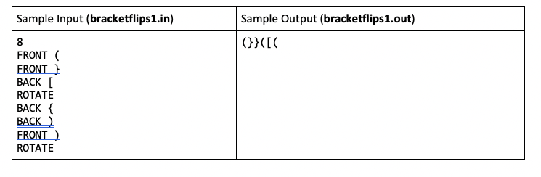
Given sample
Q : Number of Queries

Slide 10
Useful functions / Variables
Function to flip the brackets
Global boolean flag to check if data is rotated

Slide 11
DATA STRUCTURE
We use a LinkedList to for bracket storing. ( Java LL is doubly linked yay)
Each insertion O(1)
Should we use an ArrayList?

Slide 12
Rotation
Reversing a linkedList takes n/2 operation. Do we have to really rotate the list?
Can we reduce O(n) of rotate to o(1)?
Yes! Simply store a boolean rotated. Lazy rotation is thus used instead of really rotating the list.

Slide 13
Test case
Suppose we have a list of { (
Rotation will have the list become ) }. Do not change the data structure, simply have variable rotated = !rotated
Let’s say we have add front (. If rotated == true , instead of adding to the front, we add to the back. Instead of adding (, we add reverse(“(”)
For printing, if rotated is true, we simply print from the back of the list and print reverse(bracket).

Slide 14
Visualgo quiz

Slide 15
Visualgo quiz
15 questions in 10 minutes
The meeting will be recorded during quiz.
Make sure you record the whole screen including the timestamp
Upload your recording to TG group immediately after the quiz (don’t edit your message if you upload a wrong video, just send another message to upload),
and name your video as NAME+MATRIC NUMBER+ SCORE
https://visualgo.net/training?diff=Hard&n=15&tl=10&module=heap

Slide 16
PRACTICE PE - Speaker

Slide 17
PROBLEM
Implement a Data Structure that can support 2 operations.
Insert a speech that can start at time S and ends at (S + L - 1)
If overlap with another speech, ignore the operation
Remove a speech that starts at time S and ends at (S + L - 1)
If speech does not exist, ignore the operation
L is the speech duration and is constant.

Slide 18
SAMPLE IO
Q : Number of Queries
L : Fixed duration of each speech
Sample Input (speakers1.in) | Sample Output (speakers1.out)
10 4 INSERT 5 INSERT 2 INSERT 8 INSERT 1 INSERT 9 REMOVE 2 REMOVE 9 INSERT 12 INSERT 10 REMOVE 5 | Y // can insert (5 to 8) N // can’t insert (2 to 5) clash with (5 to 8) N // cant insert (8 to 11) clash with (5 to 8) Y // can insert (1 to 4) Y // can insert (9 to 12) N // no speech starting at 2 Y // can remove (9 to 12) speech Y // can insert (12 to 15) N // can’t insert (10 to 13) clash with (12 to 15) Y // can remove (5 to 8) speech 1 12 // print start time of remaining speeches

Slide 19
ANALYSIS
Two speeches will not overlap if and only if their start times a at least L apart.
For the operations, we need to search for the existence of a speech among all speeches. What are some powerful searching algorithms and or data structures we have learnt?

Slide 20
DATA STRUCTURE
We try using an ArrayList to store start times of speeches. (bad btw)
Each insertion O(n), check for collisions, if none, insert at the back.
Each deletion O(n), check for existence, remove and fill in gaps.
If we want to search more efficiently, we need a sorted collection. But we also constantly have to perform insertions and deletions at arbitrary locations (not always at front or back).
Solution: An AVL Tree can perform those operations in O(logn) time!

Slide 21
JAVA’S AVL TREES
Introducing Java.util.TreeMap<K, V> and Java.util.TreeSet<V> which essentially AVLs.
TreeSet keeps a sorted order of its generic V objects.
TreeMap keeps a sorted order of its Keys, which are individually mapped to its respective Values (like hashmap).
Both are O(logn) for basic insert, remove, contains etc.

Slide 22
AVL<K, V> Methods in Notes | TreeMap<K, V> | TreeSet<V>
insert(K key, V value) | put(K key, V value) | add(V value)
delete(K key) | remove(K key) | remove(V value)
search(K key) | get(K key)/containsKey(K key) | contains(V value)
findMin() | firstKey() | first()
findMax() | lastKey() | last()
successor(K key) | ceilingKey(K key)* higherKey(K key)* | ceiling(V value)* higher(V value)*
predecessor(K key) | floorKey(K key)* lowerKey(K key)* | floor(V value)* lower(V value)*
And many more…
* refer to java api for full descriptions because they differ.

Slide 23
EXAMPLE
10
Let L = 3
Try Insert a speech at 6. This speech will last from 6 to 8. Cannot insert because;
the next speech after 6 is 7, which is not after 8.
The prev speech before 6 is 4, which end at 6.
nextSpeech = speeches.ceiling(6)
prevSpeech = speeches.floor(6)
Notice that 6 does not have to be in the tree for us to find its “successor” etc.
4
16
1
7
20
TreeSet<Integer> speeches;
(16 represents a speech from 16 to (16 + L - 1) = 18)

Slide 24
SUGGESTED APPROACH
Use a TreeSet to store start-times of speeches.
For each insert x, we use floor(x) and ceiling(x) to check if the nearest speakers are at least L time apart from x.
For each remove x, we use contains(x) to check for existence of x and remove(x) accordingly.

Slide 25
Retransmission

Slide 26
PROBLEM
0 < N ≤ 2,000,000,000 cats, all start as asleep
Not possible to naively store the state of all cats
0 < Q ≤ 300,000 queries (sleep(x)/wake(x)/transmit(x, y))
At most 300,000 cats awake
Transmit(x,y) query returns yes IFF all cats from x to y are awake

Slide 27
Key ideas
Not possible to naively store the state of all cats
Store the transition between sleep/wake
At most 300,000 of these (because all cats start asleep)
Query transmission by checking if all cats within a range are awake
Successful IFF there is no wake->sleep transition in the range

Slide 28
Implementation
Want to quickly find the next/previous transition after an index
Treemap<wakeIndex, sleepIndex> allows for O(log(n))
When two intervals meet, combine them
To query transmission (x,y):
Find interval starting before x
Check if that interval ends after y
Interval contains (x,y) -> all cats are awake -> successful
Interval does not contain (x,y) -> some cat in the interval is asleep -> fail

Slide 29
Example
Query | Stored intervals
WAKE 4 | (4,4)
WAKE 3 | (3,4)
WAKE 6 | (3,4), (6,6)
WAKE 7 | (3,4), (6,7)
WAKE 5 | (3,7)
SLEEP 6 | (3,5), (7,7)
TRANSMIT 3 6 (fail)
TRANSMIT 3 5 (success)

Slide 30
Alternative solution (advanced)
Let awake cats have value 0, asleep have value 1
Sleep/wake -> set value of a cat
Query transmission (x,y) -> check if sum of range has value y-x (ie all cats in range are awake)
Fenwick tree + hashmap data structure allows us to do these queries in O(log(n))
Easier to code, harder to understand/debug

Slide 31
PE PRACTICE: SHOOTING

Slide 32
Qns: How to represent the chess board?
Answer:
1. If the question is interested in the ordered values of cells, like remove/poll/peak/…. largest/least value of a given row/col.
Then we should consider Heap (Priority Queue) for chess board representation like in one previous lab.
ArrayList<PriorityQueue<…>> for rows
ArrayList<PriorityQueue<…>> for cols
2. If the question is interested in just values of cells, like find a specific value and remove/poll…
And we are required to find some values bigger than a given one sometimes
Then we should consider TreeSet (AVL) for chess board representation.
ArrayList<TreeSet<…>> for rows
ArrayList<TreeSet<…>> for cols

Slide 33
Idea: Use TreeSet to maintain the chessboard status
ArrayList<TreeSet<Integer>> horizontal = new ArrayList<>(); ArrayList<TreeSet<Integer>> vertical = new ArrayList<>();
Current_X = 0, Current_Y = 0 //The cat starts at the (0, 0) position
If “SHOOT UP”:
x = vertical.get(Current_Y).lower(Current_X); // find the nearest above enemy
y = Current_Y
System.out.println(x.toString() + " " + y.toString()); horizontal.get(x).remove(y); vertical.get(y).remove(x); enemies--;

Slide 34
Finish the tail part
boolean first = true
for (int row = 0; row < N; ++row) { for (int col : horizontal.get(row)) { if (first) first = false; else System.out.print(" "); System.out.print(row + " " + col); } } System.out.println(); // End Line

Slide 35
COMPUTER GAME

Slide 36
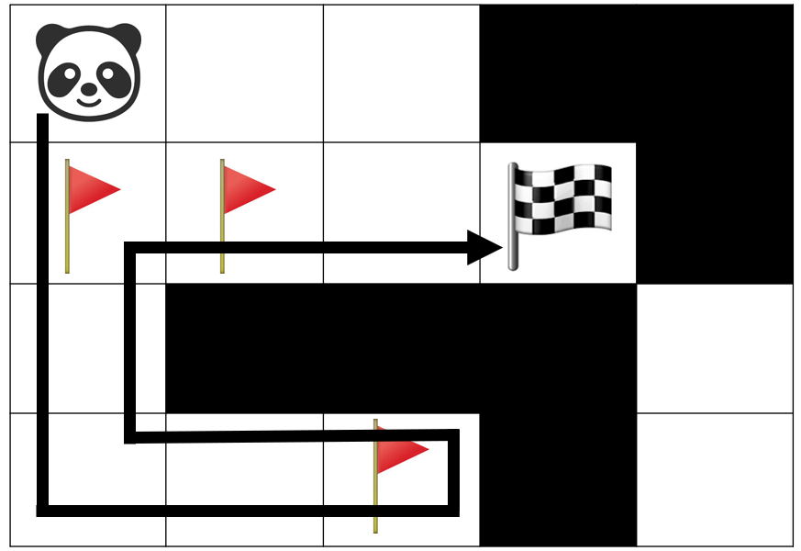
PROBLEM
Given a grid with a starting point, ending point and N checkpoints, find the minimum number of moves to collect all the checkpoints and reach the goal

Slide 37
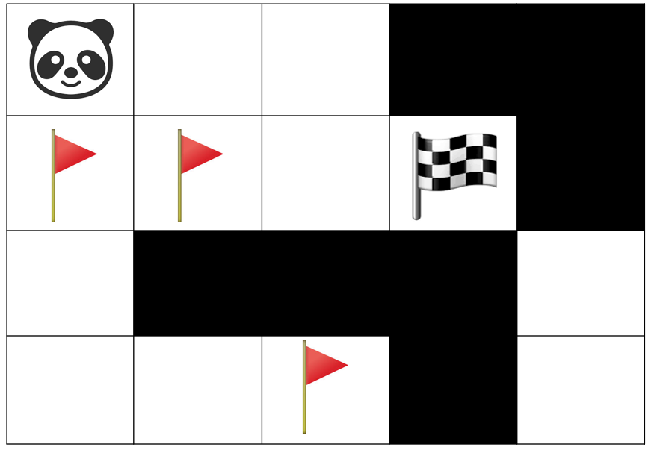
SOLUTION
We can model the grid as a graph where each cell is a vertex and between in pair of adjacent cells is an undirected, unweighted edge

Slide 38
SOLUTION
Run a BFS from the starting point to find the distance to each checkpoint
Run a BFS from the ending point to find the distance to each checkpoint
Run a BFS from each checkpoint to find the distance to all other checkpoints
Save all of these values in arrays

Slide 39
SOLUTION
Consider all possible permutations of checkpoints
Each permutation represents the order of visiting the checkpoints
E.g. S – 2 – 4 – 3 – 1 – E
You can calculate the total length of this path using all the values saved during the BFSes
Find the shortest length among all possible permutations

